Slide 1
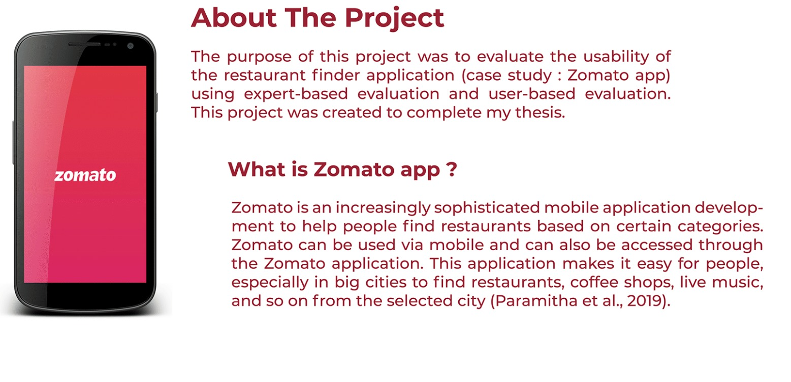

Adv Indian coder
Map my food - food delivery app
Usability Testing report
Author: Harini.S
Date: 16/03/2024

Slide 2


Table of contents
Introduction
Goals
Methodology
Participant Profiles
Tasks Tested
Post-Test Questions
Results
Bugs & Issues
Key Findings & Recommendations
Disclaimer
Appendix

Slide 3
Introduction
The purpose of the project waste to evaluate the usability of the restaurant finder application(Zomato app) using expert based evaluation and user based evaluation. Zomato is a popular online food delivery and restaurant discovery platform with a significant global user base. While it has gained popularity, there are areas where the user experience could be improved. This updated user research report aims to present the findings and insights gathered to enhance the user experience on Zomato by addressing the identified pain points

Slide 4
Goals
User based evaluation
Identify
bugs
& issues
Reveal
friction
points
The collected data from user interviews, user testing, and surveys were analyzed to identify common pain points and insights.
Users’ interactions with the Zomato app and website were observed to identify usability issues.
ability to prioritize action items is its real-time order tracking feature and addressing any potential issues promptly.
To ensure better user experiences and product sucess
To avoid costly fixes and negative reviews post-release.
which allows users to monitor the status of their food delivery, with timely updates.

Slide 5
Methodology:
- The research methodology included: (i) User interviews: In-depth interviews were conducted with a diverse group of Zomato users to understand their experiences, challenges, and expectations. (ii) User testing: Users’ interactions with the Zomato app and website were observed to identify usability issues. (iii) Surveys and questionnaires: Online surveys were administered to a larger sample of Zomato users to gather quantitative data on user satisfaction and preferences. (iv) Data analysis: The collected data from interviews, user testing, and surveys were analyzed to identify common pain points and insights.

Slide 6
Participant Profiles
Our pool of 10 testers consisted of young adults aged between 18-35 years old. The majority of our testers were male (65%) and 50% of testers were familiar with (name of organisation). Professionally, our testers came from a variety of career backgrounds that fell into (zomato) target demographic.
Notes:
Task 1 - Users are asked to evaluate the website as a whole from their preferred device. They are asked to find a certain product starting from home page.
Task 2 - Users are asked to show researcher how they would compare 2 products within Grassphere's website.
Task 3 - Users are asked to add a product to shopping cart and complete the checkout flow on prototype.

Slide 7
Tasks Tested
Task 1 – Create account
Task 2 – Log in
Task 3 – Click on online shop button
Task 4 – select item
Task 5 – payment

Slide 8
Post-Test Questions
How would you describe this product to someone?
What was your favourite aspect of the product?
What was the most confusing part of the test?
Would you continue using this product?
Would you recommend this product to a friend or colleague?

Slide 9
Results

Slide 10
Sentiment Analysis
Overview of Results
40% of participants enjoyed this specific experience
60% of participants complained about this specific experience
Positive
its intuitive user interface, which simplifies the process of finding and ordering food, leading to increased user satisfaction and engagement during usability testing.
Negative
60% of participants over the age of 30 were found difficulites in sign in button thus sign in through mail,facebookand google are too closer to each other

Slide 11
Bugs & Issues
1.Inconsistent navigation: Confusing button placements and labeling.
2.Slow performance: Delays in loading and browsing.
3.Confusing search filters: Overwhelming options, unclear instructions.
4.Inaccurate restaurant info: Discrepancies in menu, prices, and hours.
5.Accessibility lacking: Limited support for disabilities.
6.Checkout inefficiency: Complicated process, potential order abandonment.
7.Unresponsive interface: Delayed interactions disrupt user flow.
8.Low-quality images: Poor resolution affects visual appeal.
9.Limited personalization: Few options for tailored recommendations.
10.Poor error handling: Confusing error messages, lack of guidance.

Slide 12
Key Findings & Recommendations

Slide 13

Major
Findings:
Navigation challenges
Search functionality issues
Problems with filtering and sorting
Incomplete restaurant information
Ordering process complexities
Account management difficulties
Feedback and ratings hurdles
Performance concerns
Error handling problems
Accessibility issues

Slide 14

Recommendation:
Personalized Recommendations
2. Visual Search
3. Interactive Reviews
4. Live Order Tracking
5. Gamified Loyalty Program
6. Voice-Activated Ordering
7. AR Menu Translations
8. Community Food Challenges

Slide 15
Disclaimer
all the participants follow the set agenda
Were there no human errors that affected the results
Were there no user biases that might have had an impact on the results
A series of product bugs and errors occurred (listed above)

Slide 16
Appendix
Participant criteria
Test Task
Metrics
Find a dinner restaurant with specific dietary needs
Age:18-60
99% of task success rate
Weekly Zomato usage
January 2024-March 2024
Order a meal for delivery
Intermediate to advance app familiarity
Exploring new trending rrestaurants feature
40% satisfaction rate

Slide 17

Adv Indian coder
Thank you!

